Slide 1
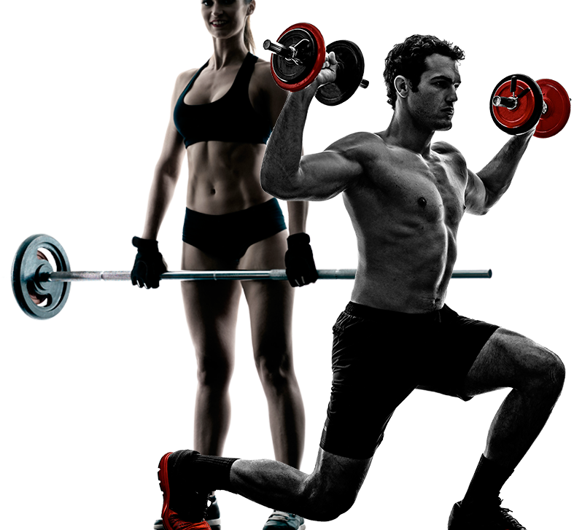

FITNESS
Your Health, Our Focus.
BOOTCAMP

Slide 2
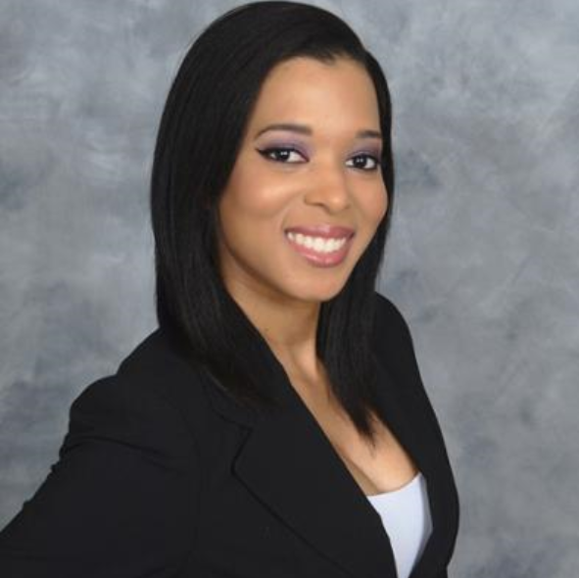



Meet our fitness
team
DERILEE WALTERS
STEVEN QUINTERO
MANAGER
HEALTH ANALYST
KIM PHUONG​
Liseth RUBIO
PERSONAL TRAINER CLASS A
PERSONAL TRAINER CLASS D

Slide 3
WHO ARE WE?
We are FitnessBootcamp, a healthcare-focused gym using a supervised machine learning model to classify members into two categories based on their Biometrics and Fitmetrics. This optimized model helps us tailor personal training sessions to maximize each member's fitness and health outcomes.

Slide 4
Products
Biometrics
Fitmetrics
Grip Force
FitClassify model
CLASS A
Sit and Bend
Sit-Ups Count
Body Fat %
Blood Pressure
Weight
Height
Broad Jump
CLASS D
And services

Slide 5
Let’s get you started!

Slide 6
Fitclassify model:
Introduction
FitClassify Model Optimization
PART 1: Data Cleaning
PART 2: Labels Set (y) vs. Features (X)
PART 3: Training and Testing Sets
PART 4: Fit and Transform data
PART 5: Optimization of FitClassify Model Using
Keras Sequential Model
Confusion Matrix
Random Forest
3. Analysis
4. Conclusion

Slide 7
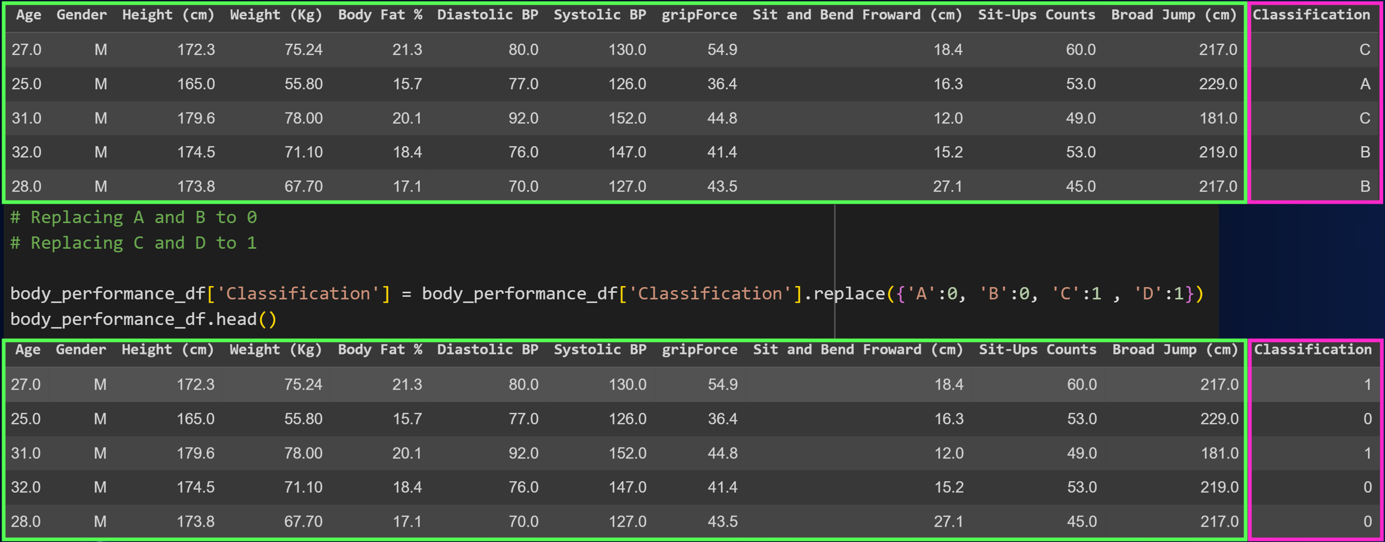
Biometrics & fitmetrics: Cleaning data
PART 1
Notes:
Explanation of which columns are the features and the label column.
Explanation of why (binary classification for better accuracy) and how (.replace function) the label column (‘CLASSIFICATION’) was changed to two options (A, B = 0; C, D = 1)

Slide 8
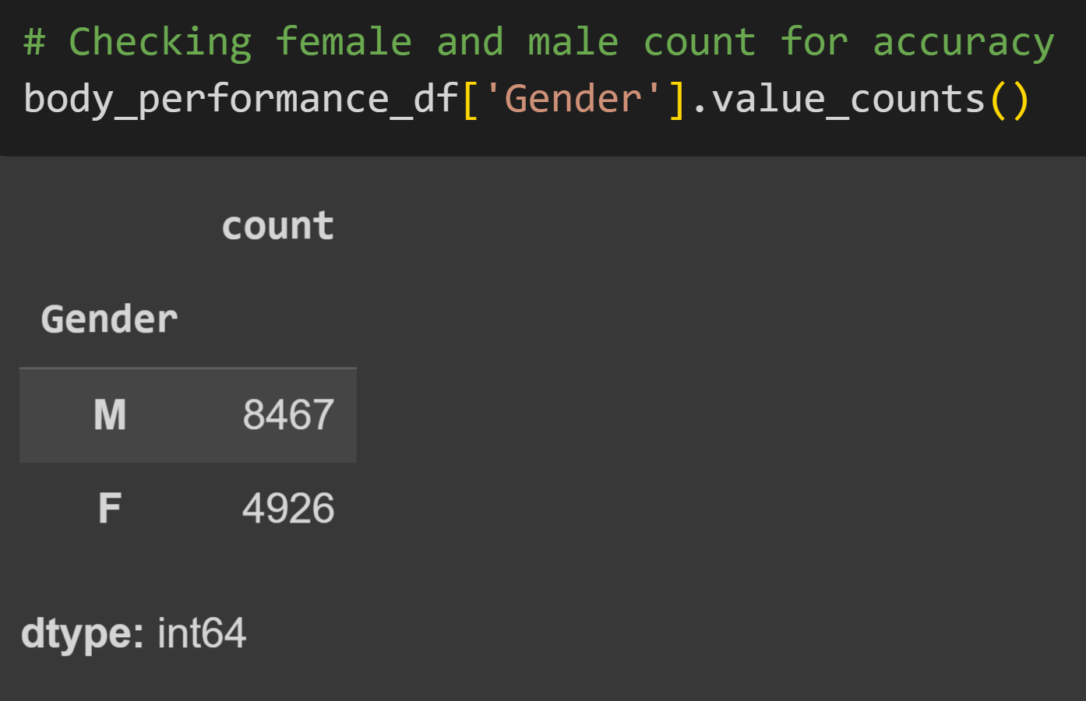
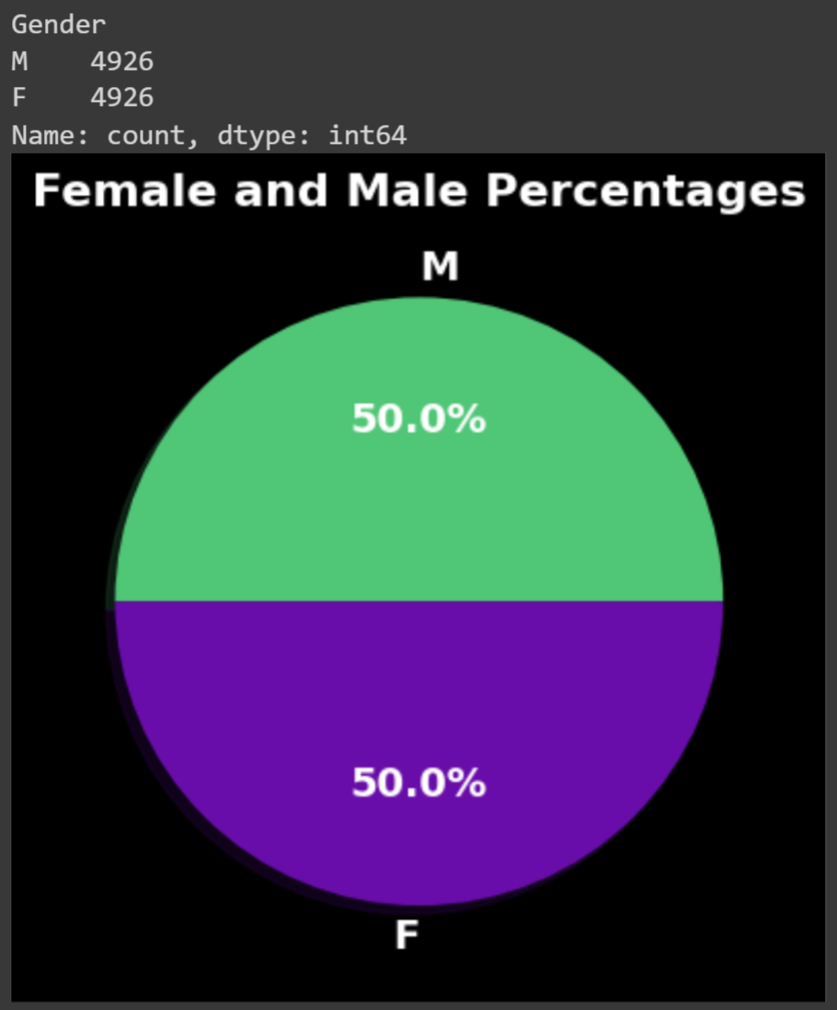
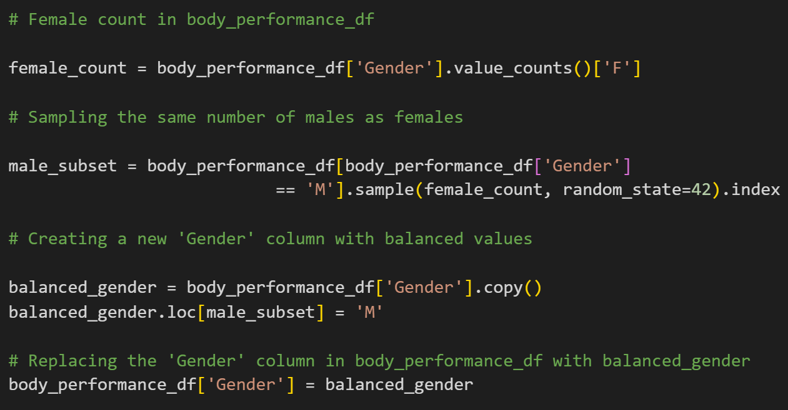
Biometrics & fitmetrics: Cleaning data
PART 1
Notes:
Explanation of which columns are the features and the label column.
Explanation of why (binary classification for better accuracy) and how (.replace function) the label column (‘CLASSIFICATION’) was changed to two options (A, B = 0; C, D = 1)

Slide 9
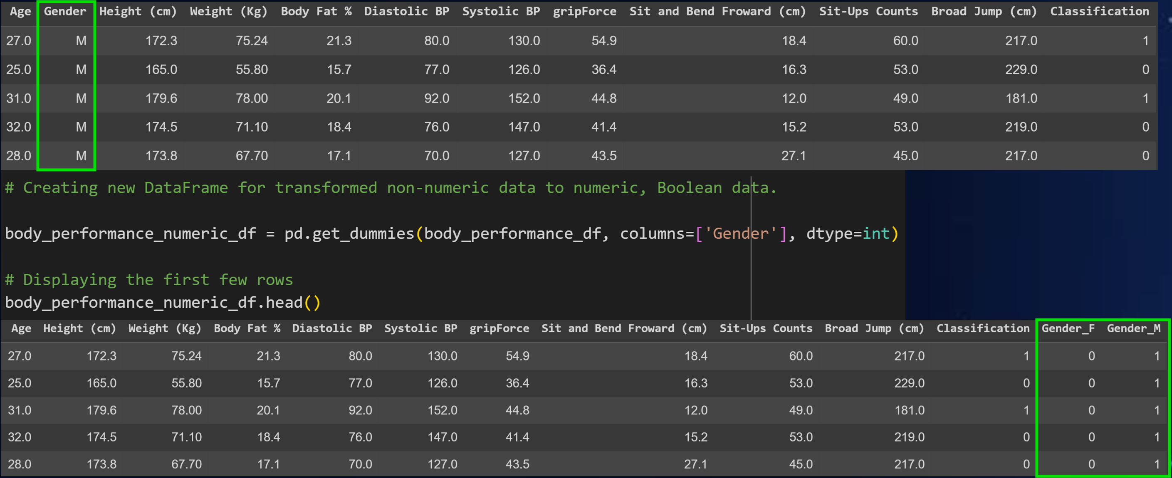
Biometrics & fitmetrics: Cleaning data
PART 1
Notes:
Explanation of which columns are the features and the label column.
Explanation of why (binary classification for better accuracy) and how (.replace function) the label column (‘CLASSIFICATION’) was changed to two options (A, B = 0; C, D = 1)

Slide 10
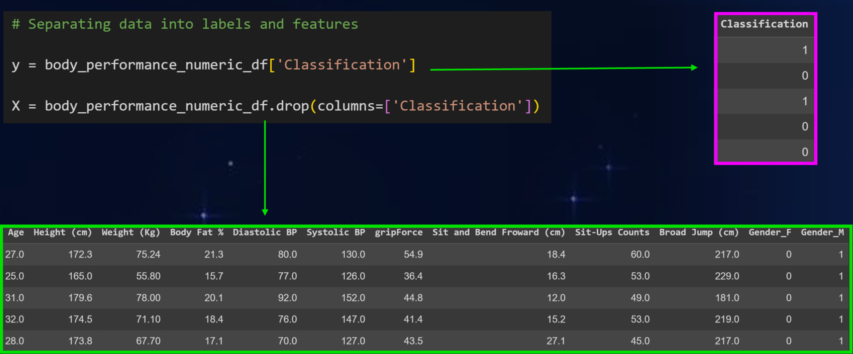
Labels set (y) vs features (x)
PART 2

Slide 11
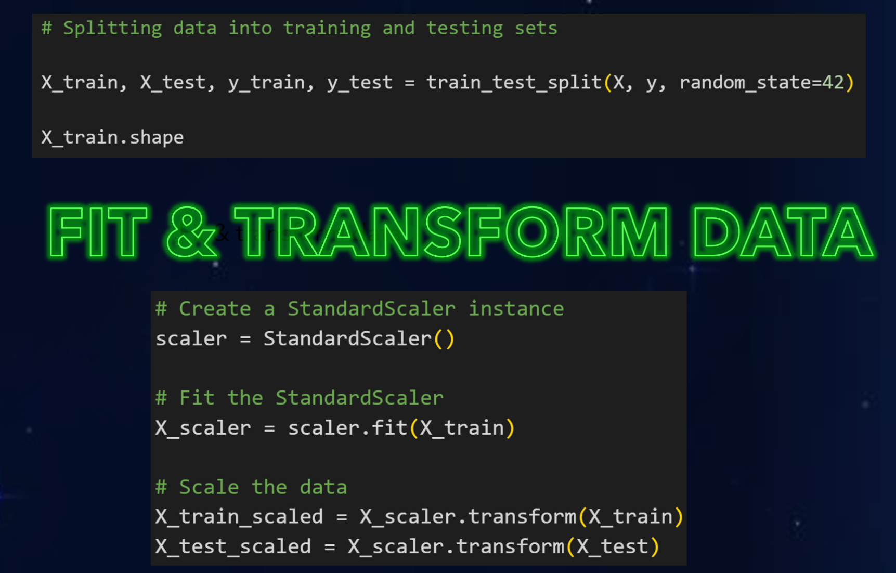
Training and testing sets
PART 3
PART 4
Fit & transform data

Slide 12
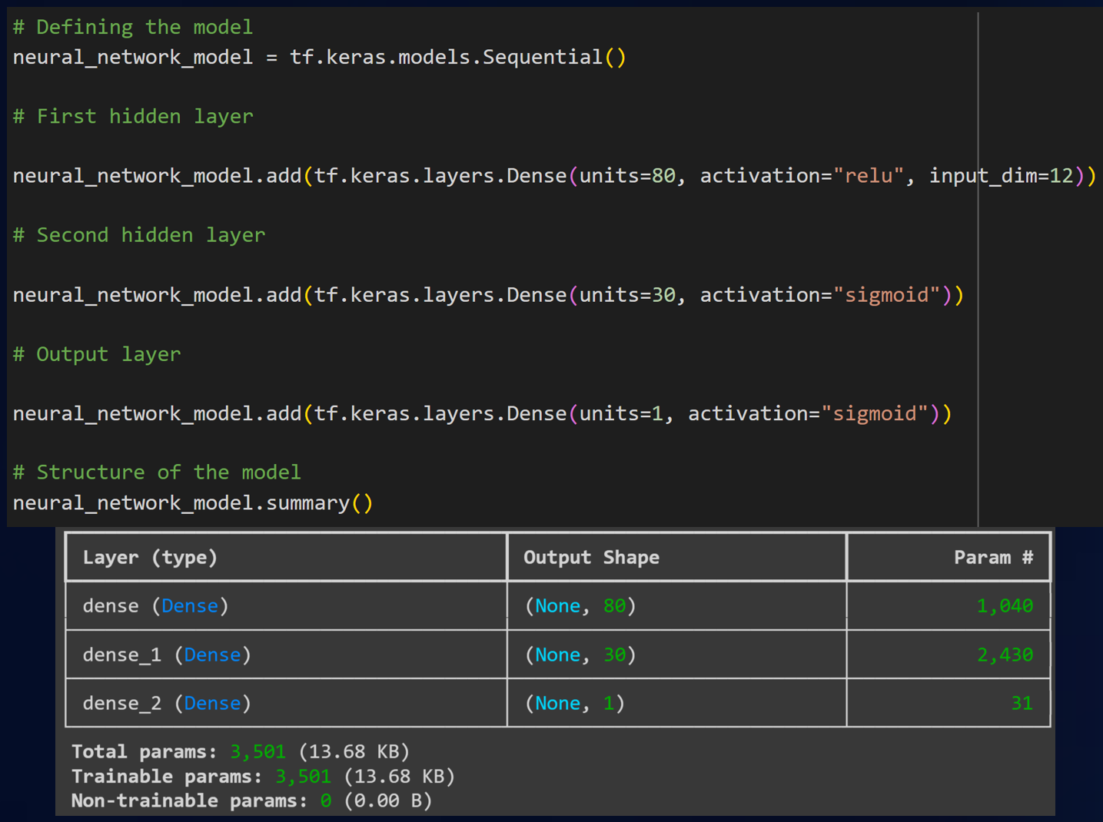
Fitclassify modeL: KERAS SEQUENTIAL
PART 5

Slide 13
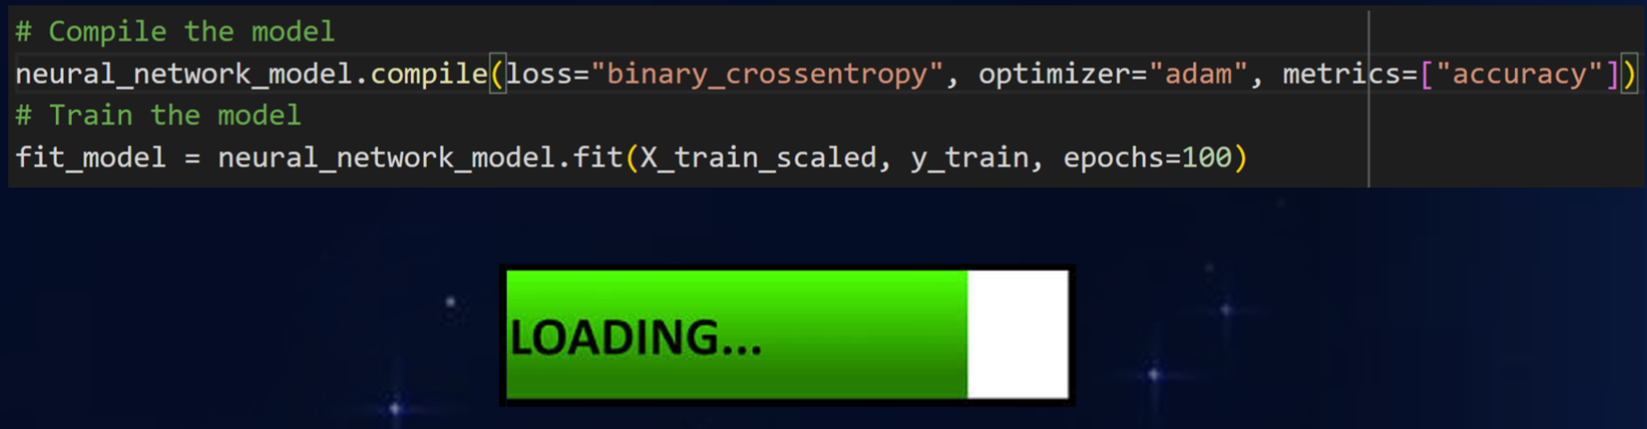
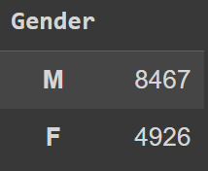
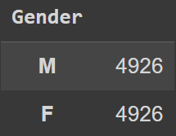
Fitclassify modeL: KERAS SEQUENTIAL
PART 5

Slide 14
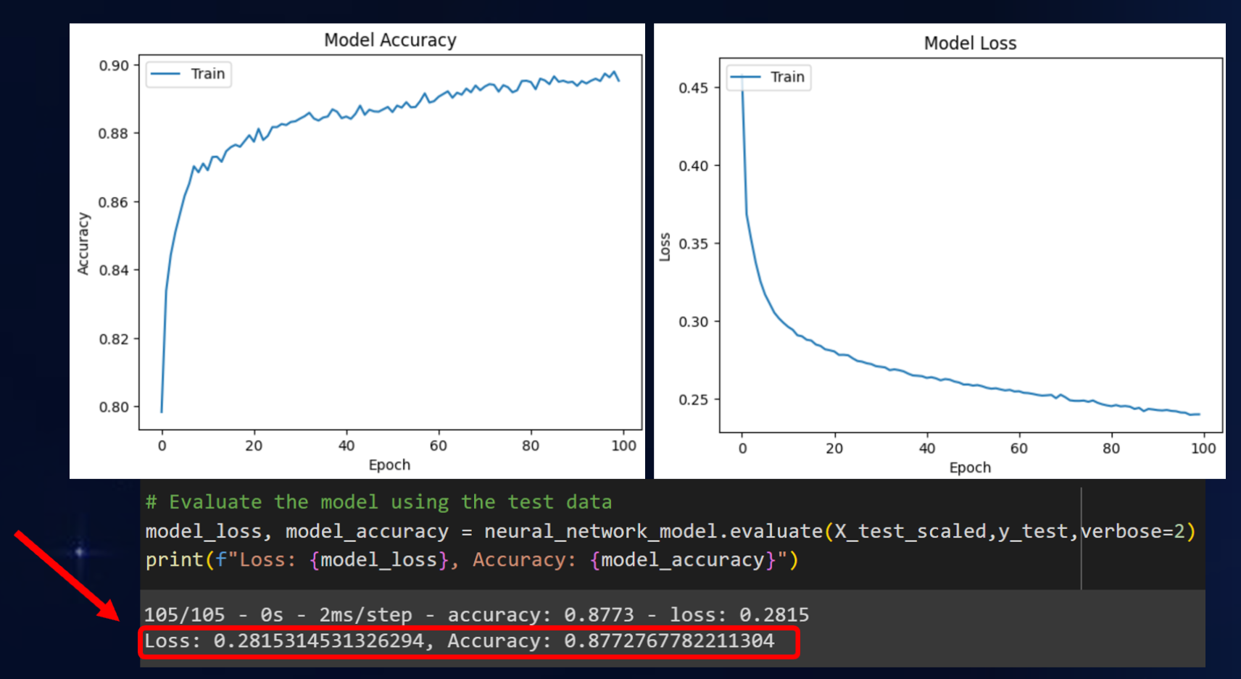
Fitclassify modeL: KERAS SEQUENTIAL
PART 5
Trained
Subsets
Tested
Subsets

Slide 15
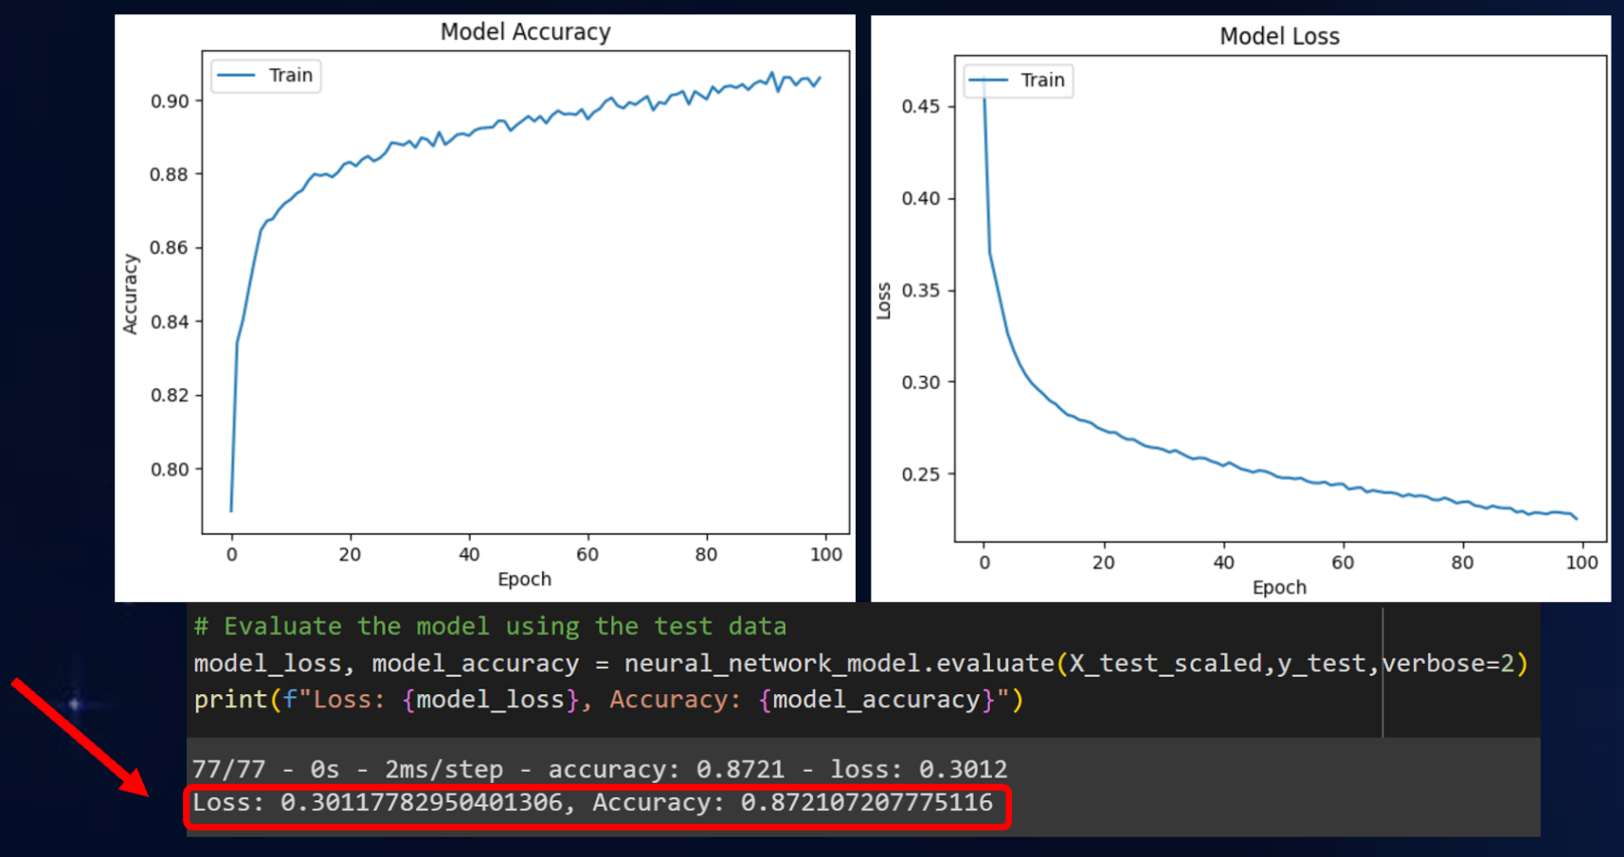
Fitclassify modeL: KERAS SEQUENTIAL
PART 5
Trained
Subsets
Tested
Subsets

Slide 16
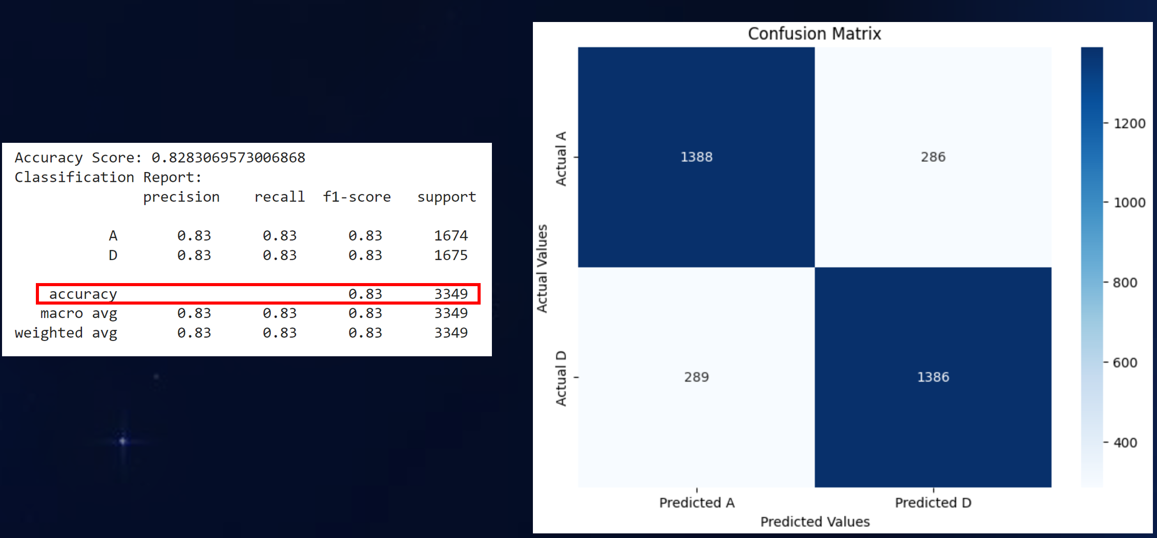
Fitclassify model: Confusion matrix
PART 5

Slide 17
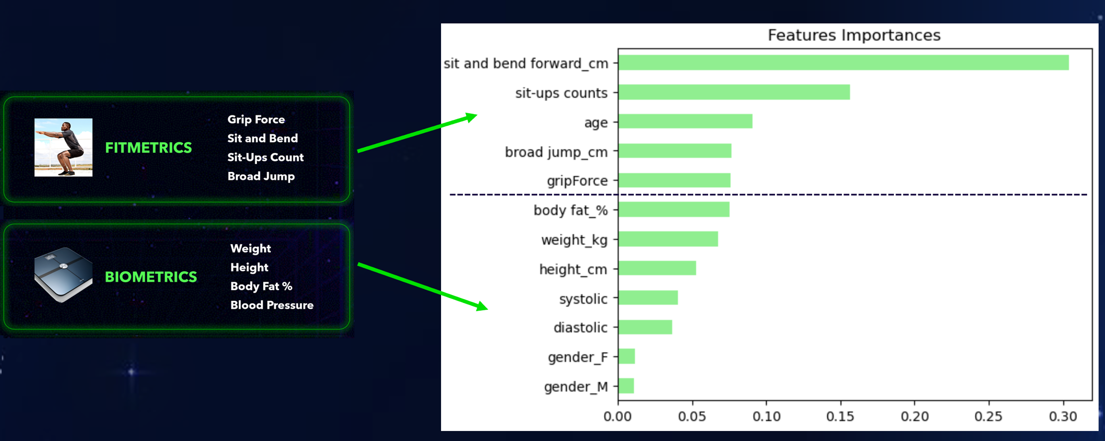
Fitclassify model: random forest
PART 5

Slide 18
Analysis
Data Cleaning: balanced female and male count
Classification Labels:
Categories A & B = 0 (Best performance).
Categories C & D = 1 (Not best performance).
Keras Sequential Model Results:
Non-balanced model: 87.7% accuracy on testing subsets.
Balanced model: 87.2% accuracy on testing subsets.
0.5% decrease in accuracy for the balanced model.
The minimal 0.5% percentage change in accuracy is due to the low weight of the gender feature in the dataset (random forest analysis).

Slide 19
conclusion
Our FitClassify model can accurately classify the health of our clients, and we can use this as a tool to help market our FitnessBootcamp services.

Slide 20
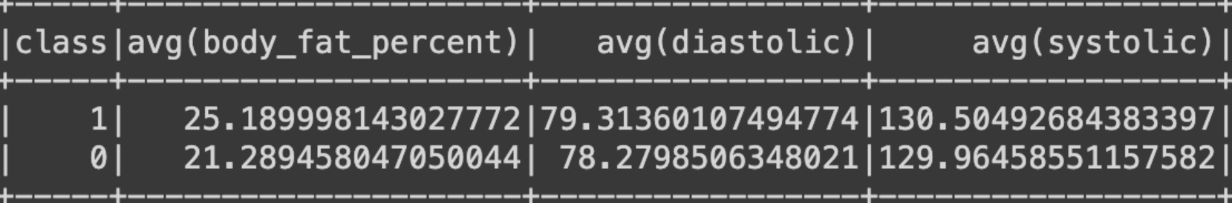
Future member
We recommend:
BodyFat % ~ 21.3% 2 sessions/week 8 sessions/month
CLASSIFICATION A (0)
We recommend:
BodyFat % ~ 25.2% 4 sessions/week 16 sessions/month
CLASSIFICATION D (1)
\
Notes:
CLASS A = A + B = (20.5) + (22.0) = 42.5/2 = 21.25%
CLASS D = C + D = (22.6) + (27.7) = 50.3/2 = 25.15%

Slide 21
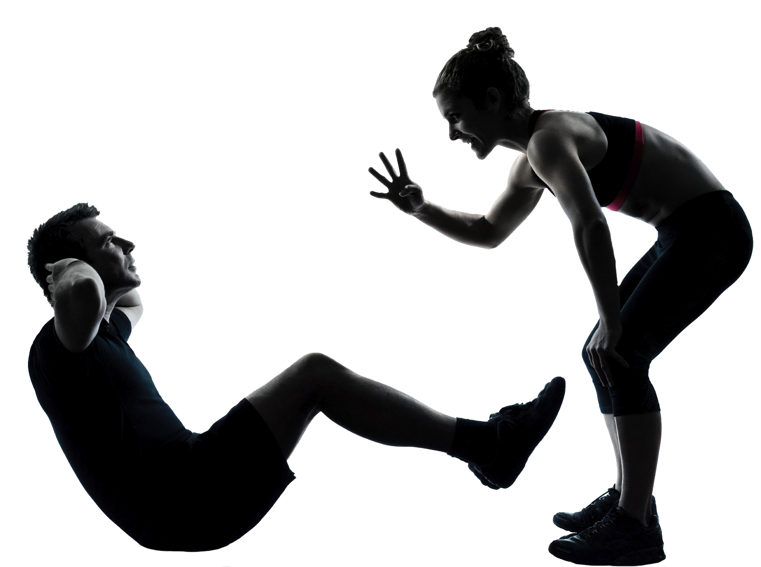
Contact
fitnessbootcamp@gmail.com

